Slide 1

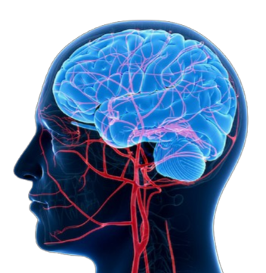
Metro College of Technology
Toronto
Comprehensive Analysis of
Brain Stroke Prediction
Final project - DM Course
By Shirmila Hewapathirana
Professor: Mr. Amit Kukreja
Submitted on February 19, 2025

Slide 2
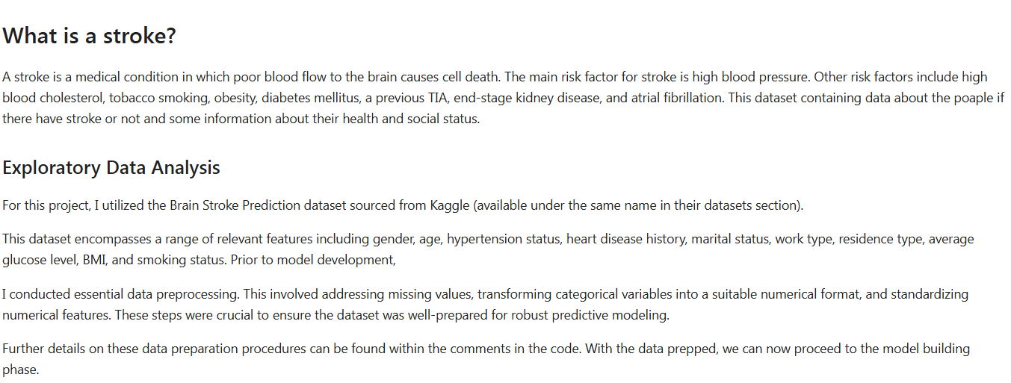
Executive Summary

Slide 3
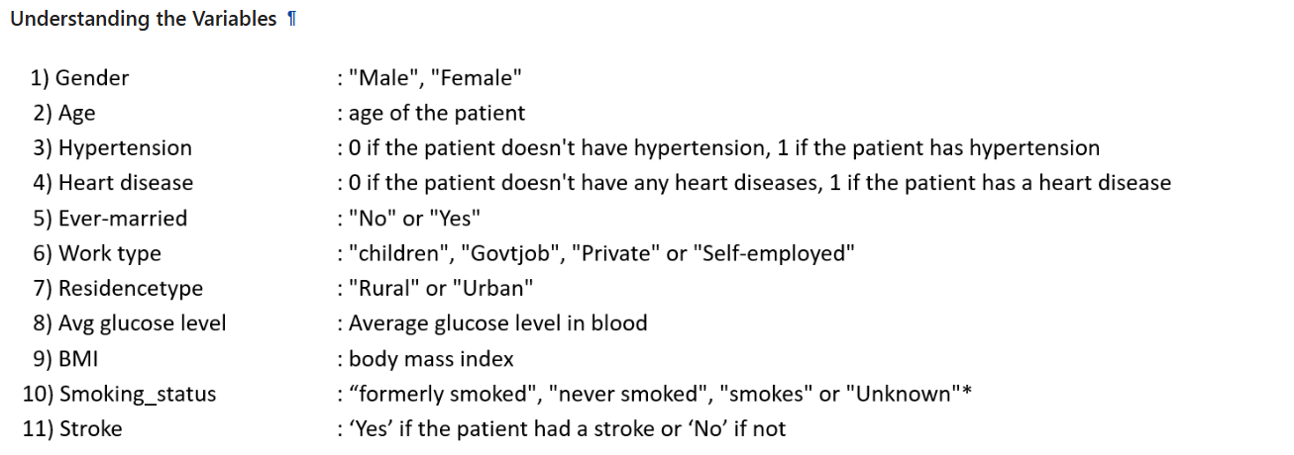
Summary of Dataset

Slide 4
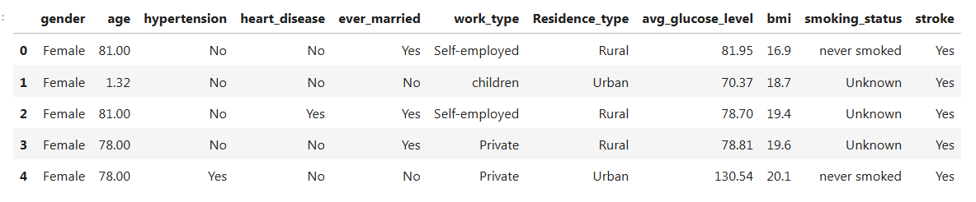
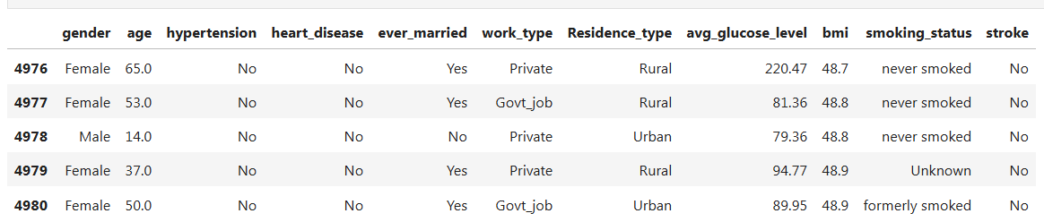
Head and Tail of the Dataset

Slide 5
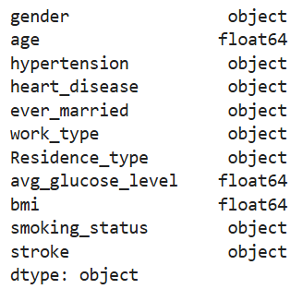
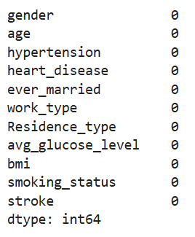
Data Types Missing Entries
Note: No Duplicated records

Slide 6
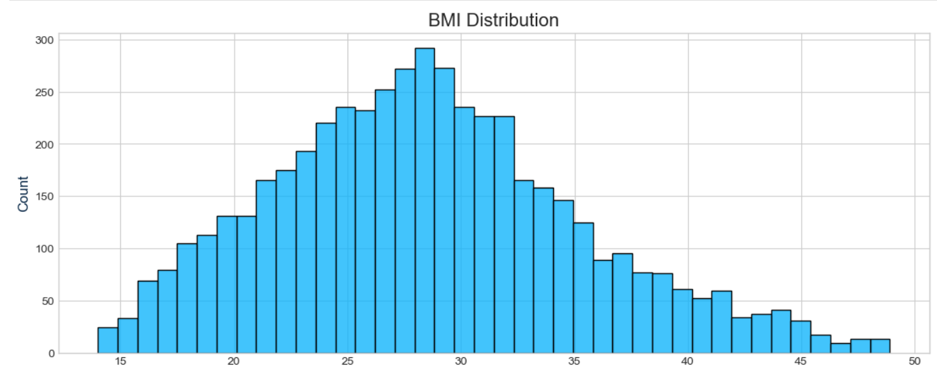
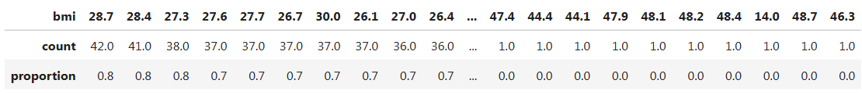
Univariate Analysis: Numerical Data – ‘BMI’ Distribution

Slide 7
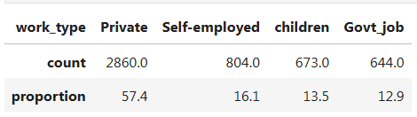
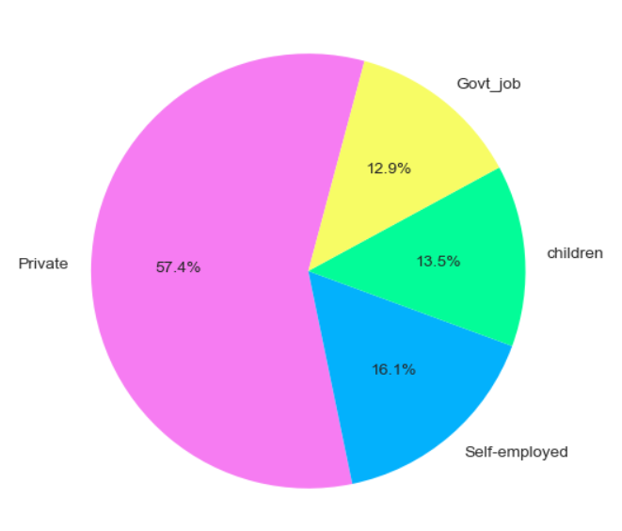
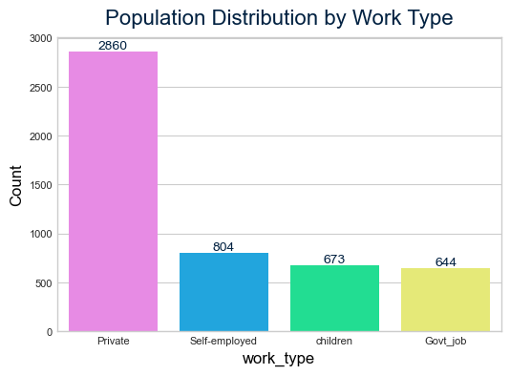
Univariate Analysis: Categorical Data – Population Distribution by Work Type

Slide 8
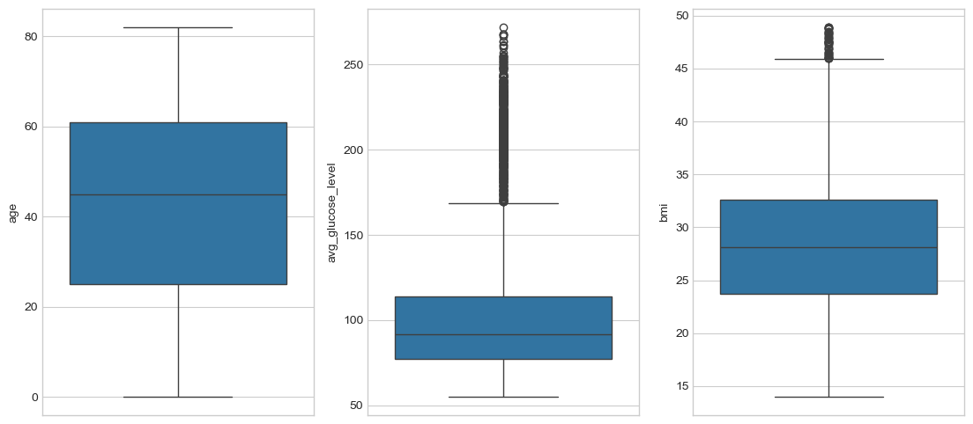
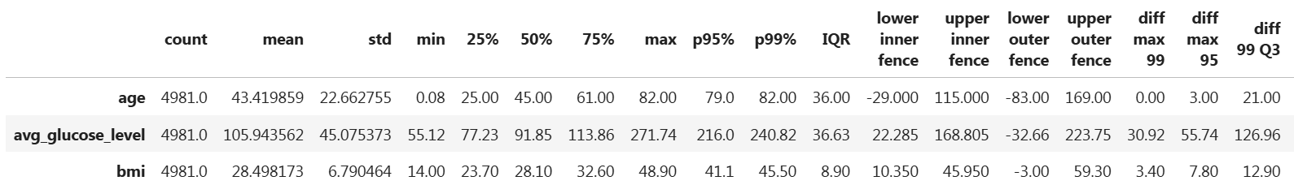
Outlier Detection: Tukey Method

Slide 9
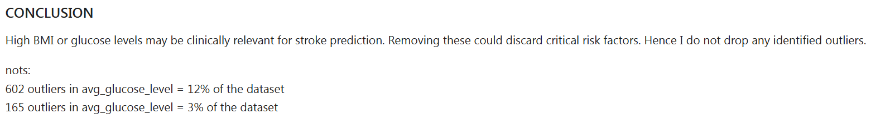
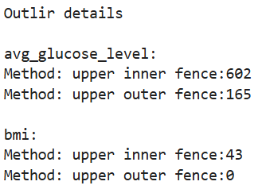
Outlier Detection: Tukey Method

Slide 10
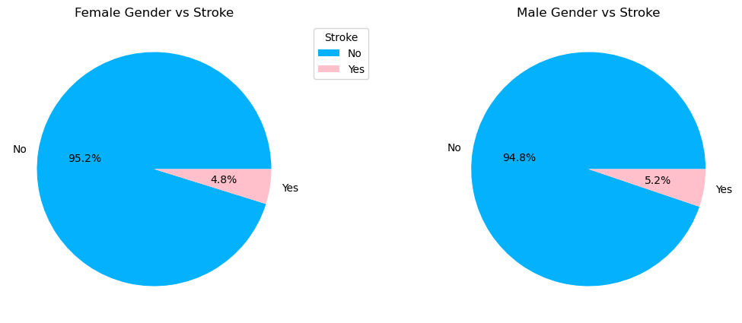
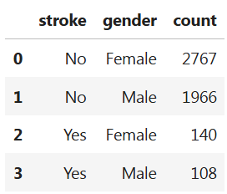
Bivariate Analysis: Categorical Data – Stroke by Gender

Slide 11
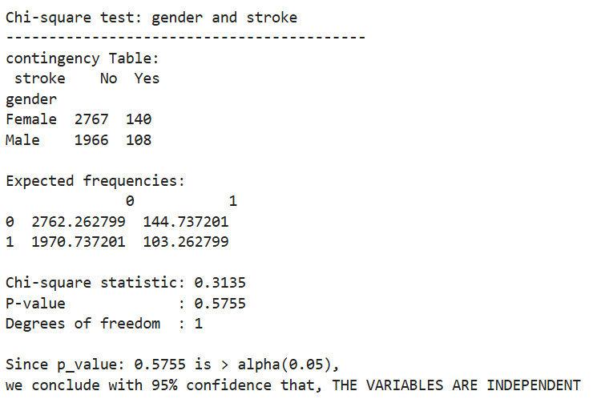
Bivariate Analysis: Chi-Square Test – Gender vs Stroke
HO: There is no association between STROKE and GENDER;
H1: There is an association between STROKE and GENDER;

Slide 12
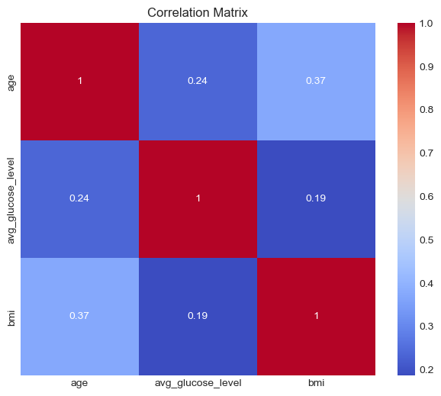
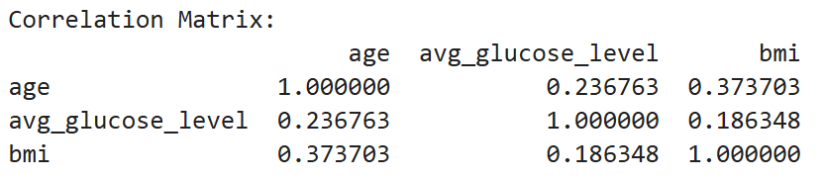

Correlation Analysis: Numeric Data – ‘age’, ‘avg_glucose_level’, ‘bmi’

Slide 13
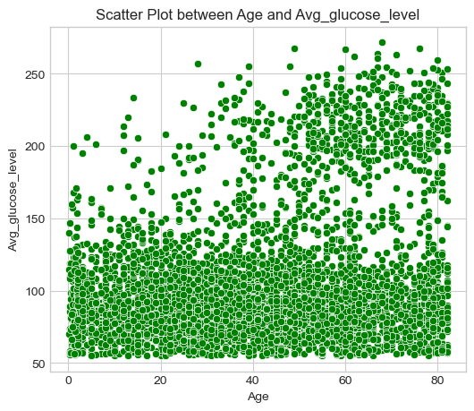
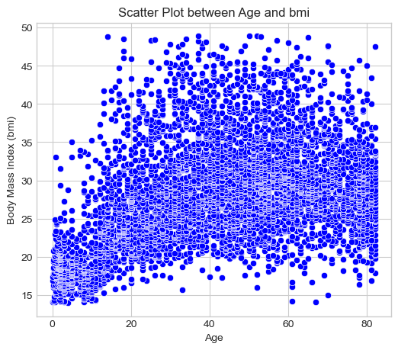
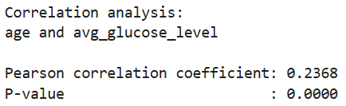
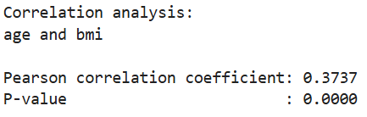
Correlation Analysis: Numeric Data – ‘age’, ‘avg_glucose_level’, ‘bmi’

Slide 14
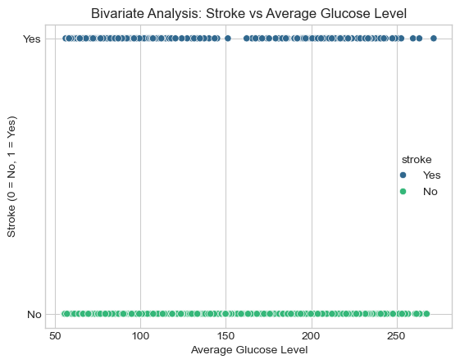
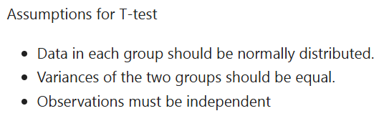
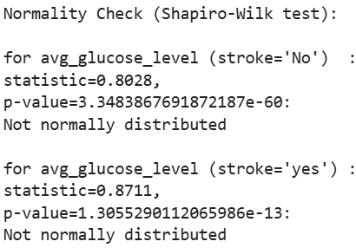
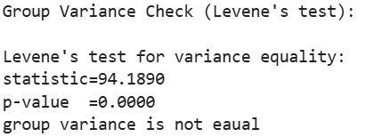
Bivariate Analysis: T-Test/Mann Whitney-U – Avg. Glucose Level vs Stroke
*HO: The mean of Avg.glucose_level is equal between people with and without stroke.
*H1: The mean of Avg.glucose_level is not equal between people with and without stroke.
Stroke is an independent group

Slide 15
Bivariate Analysis: T-Test/Mann Whitney-U – Avg. Glucose Level vs Stroke
*HO: The mean of Avg.glucose_level is equal between people with and without stroke.
*H1: The mean of Avg.glucose_level is not equal between people with and without stroke.
Mann-Whitney U test: statistic=45752.0000 p-value =0.0000
Decision and Conclusion
Since the p-value < 0.05 for the Mann Whitney U test, we reject the null hypothesis and conclude that people with and without stroke have a statistically significant difference in their average Glucose Level.

Slide 16
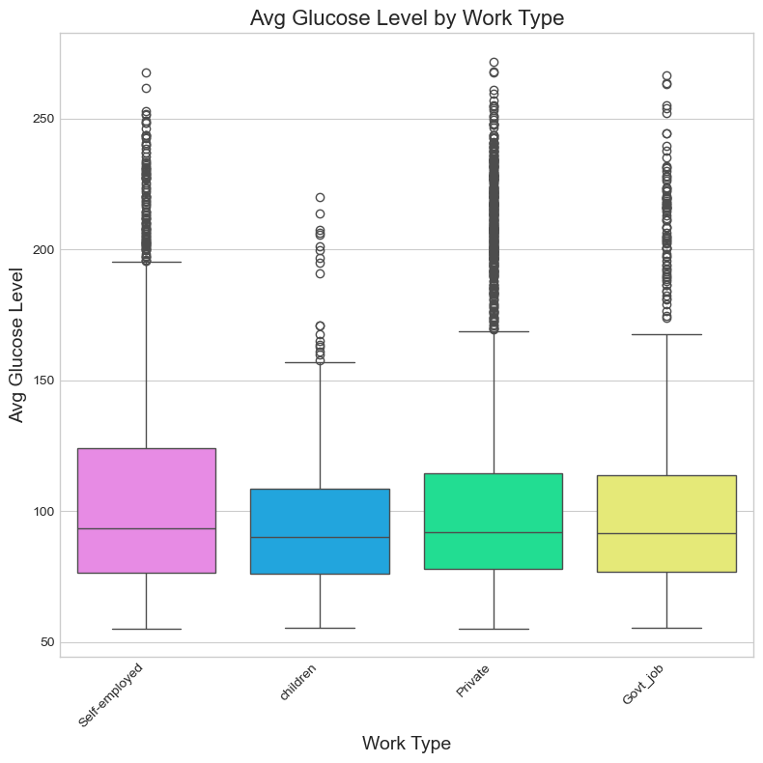
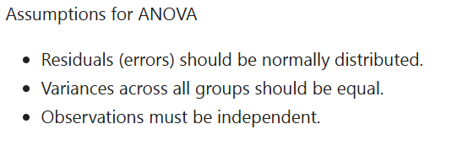
Bivariate Analysis: Anova – Avg. Glucose Level by Work Type(Multi Level)
*H0: There is no difference between
the mean average glucose levels
for all work types;
*H1: There is a difference between the
mean average glucose levels for
at-least one work type compared
to the others.

Slide 17
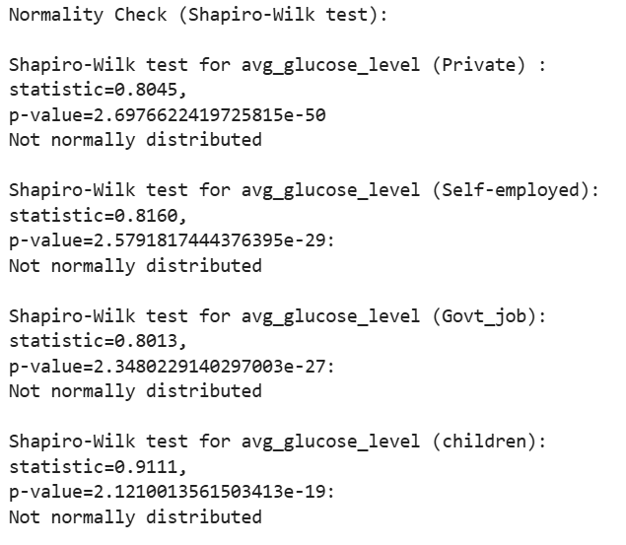
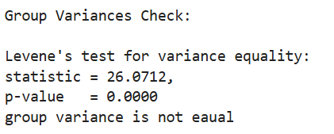

Bivariate Analysis: Anova – Avg. Glucose Level by Work Type(Multi Level)
Since, Anova assumptions are not fully met, I chose to perform Kruskal Wallis Test
Performing Kruskal-Wallis test
Kruskal-Wallis statistic: 16.0352, p-value=0.0011
𝐻0: The medians of all groups are equal
H1: At least one group's median is different from the others.
Since p-value < 0.05, we reject the null hypothesis, means that the medians of group are not equal.
Null hypothesis

Slide 18
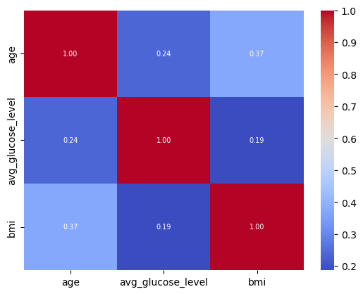
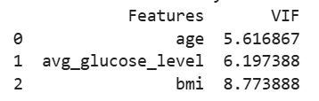
Collinearity and Multicollinearity : Numerical Features
Check Multi Collinearity using VIF (variance Inflation Factor)
There are 0 variables with VIF score greater than 10. No action is required
Perusal of above heatmap explains us that there is no significant correlation in above variables

Slide 19
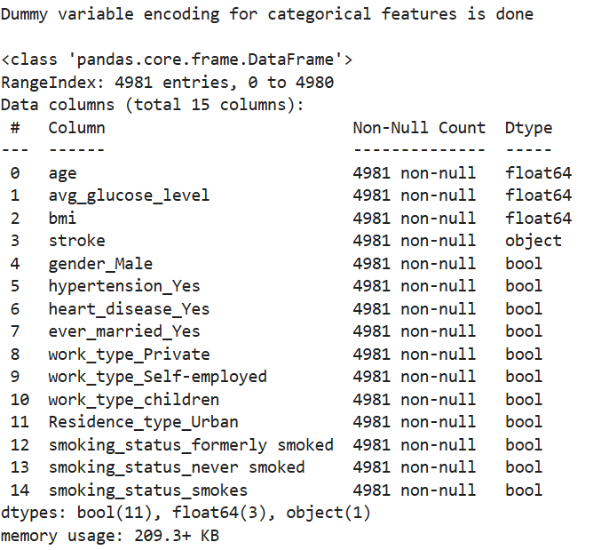
Encoding Categorical Features
This is required for models like linear regression to avoid the problem of high collinearity
amongst independent variables. I chose One hot encoding using ‘get_dummies’ function in Pandas

Slide 20
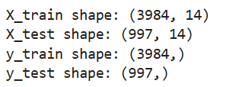
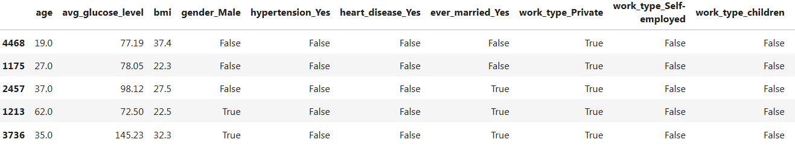
Split Dataset into Train Test Data (Test size: 20%)
X TRAIN DATA

Slide 21
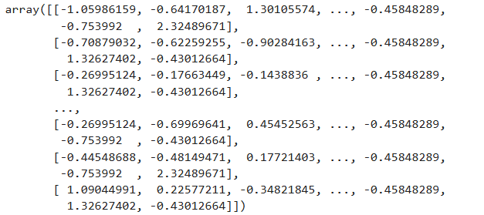
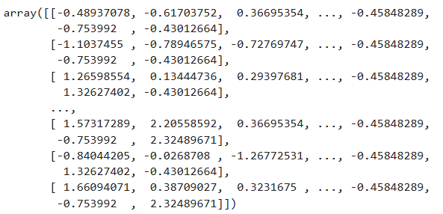
Split Dataset into Train Test Data (Test size: 20%)
Scaled X_train data
Scaled X_test data

Slide 22
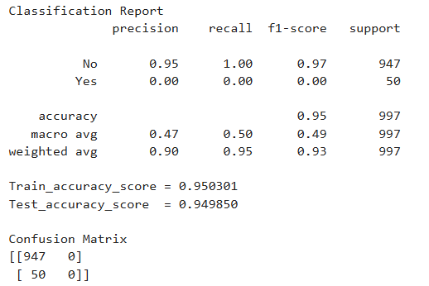
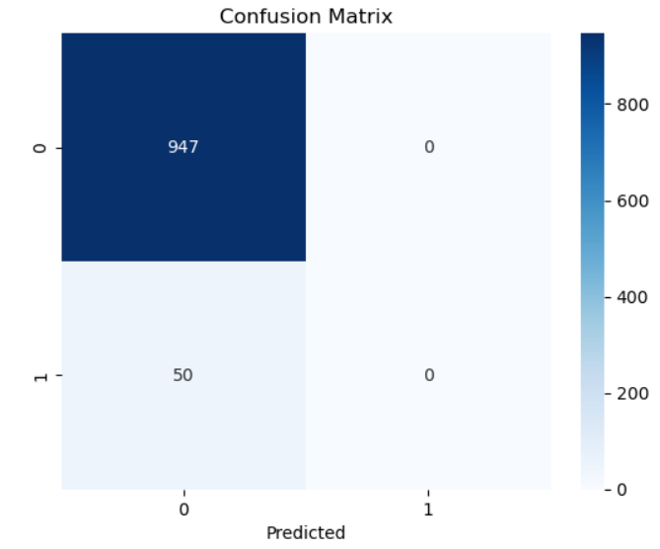
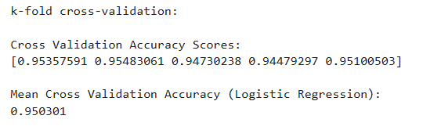
LOGISTIC REGRESSION AND DECISION TREE ANALYSIS
Logistic Regression and Decision Tree Classifier
The cross-validation results suggest that the logistic regression model is performing well and generalizes effectively

Slide 23
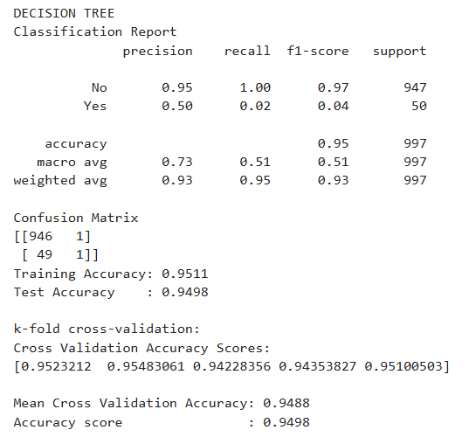
LOGISTIC REGRESSION AND DECISION TREE ANALYSIS
Logistic Regression and Decision Tree Classifier

Slide 24
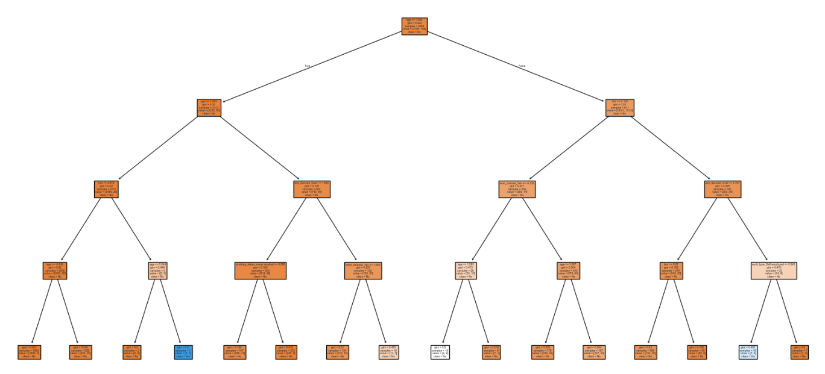
LOGISTIC REGRESSION AND DECISION TREE ANALYSIS
Logistic Regression and Decision Tree Classifier

Slide 25
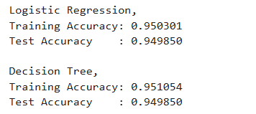
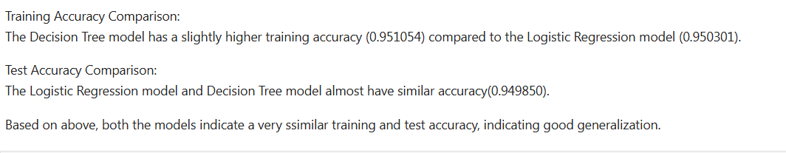
Overfitting Check: Compare Training & Test Accuracy

Slide 26
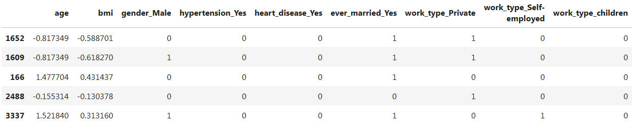
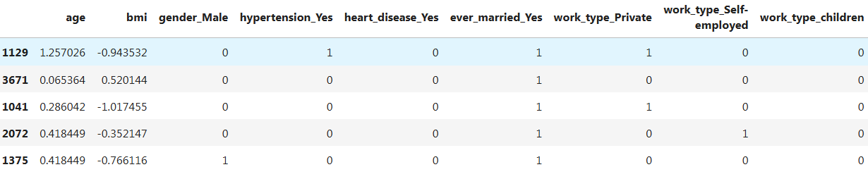
Linear Regression and Regression Tree

Slide 27
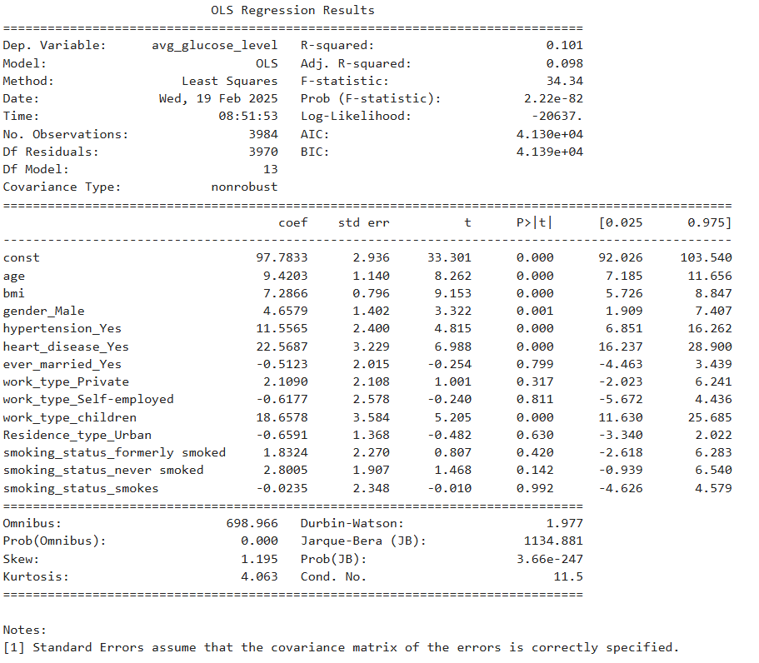
Linear Regression and Regression Tree

Slide 28

Linear Regression and Regression Tree

Slide 29

Linear Regression and Regression Tree

Slide 30



Linear Regression and Regression Tree

Slide 31
Thank you!

